Slide 1
ER Diagram
Arth Desai, Dapeng Jin, Jin Xu, Xuenan Wang, Wenhao Luo

Slide 2
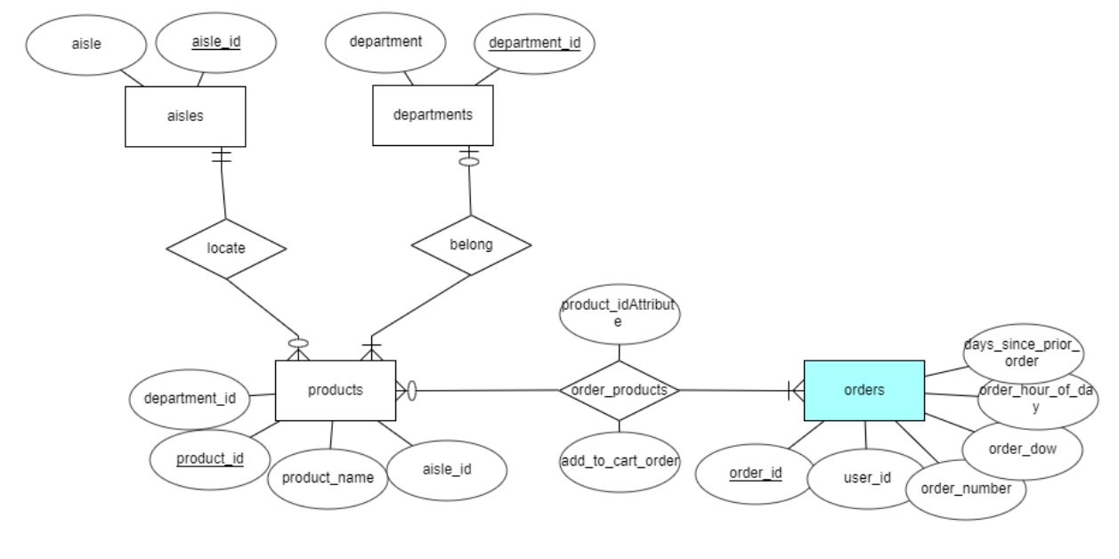
ER Diagram

Slide 3
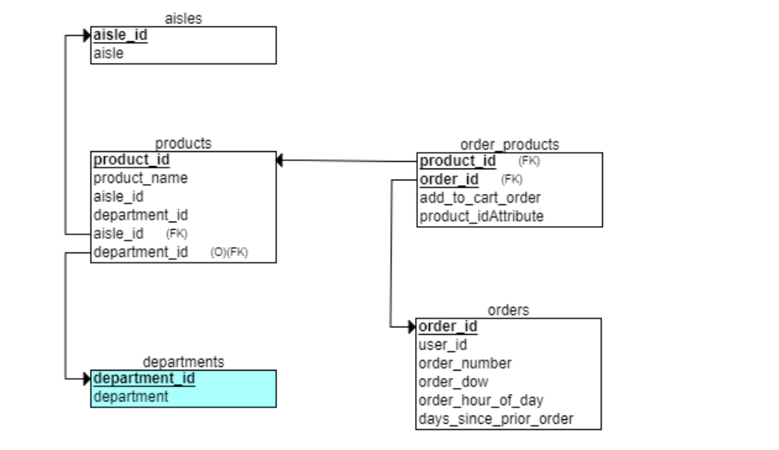
R
Relational Schema

Slide 4
SQL Script
CREATE TABLE aisles
(
aisle_id INT NOT NULL,
aisle INT NOT NULL,
PRIMARY KEY (aisle_id)
);
CREATE TABLE departments
(
department_id INT NOT NULL,
department INT NOT NULL,
PRIMARY KEY (department_id)
);
CREATE TABLE orders
(
order_id INT NOT NULL,
user_id INT NOT NULL,
order_number INT NOT NULL,
order_dow INT NOT NULL,
order_hour_of_day INT NOT NULL,
days_since_prior_order INT NOT NULL,
PRIMARY KEY (order_id)
);

Slide 5
SQL Script
CREATE TABLE products
(
product_id INT NOT NULL,
product_name INT NOT NULL,
aisle_id INT NOT NULL,
department_id INT NOT NULL,
aisle_id INT NOT NULL,
department_id INT,
PRIMARY KEY (product_id),
FOREIGN KEY (aisle_id) REFERENCES aisles(aisle_id),
FOREIGN KEY (department_id) REFERENCES departments(department_id)
);
CREATE TABLE order_products
(
add_to_cart_order INT NOT NULL,
product_idAttribute INT NOT NULL,
product_id INT NOT NULL,
order_id INT NOT NULL,
PRIMARY KEY (product_id, order_id),
FOREIGN KEY (product_id) REFERENCES products(product_id),
FOREIGN KEY (order_id) REFERENCES orders(order_id)
);

Slide 6
Thanks!

